Slide 1
CompTIA A+ Certification 801 Support Skills
Unit 1.3 Power Supplies

Slide 2
Identify the parts and connectors of a PC Power Supply Unit (PSU)
Select and install a PSU appropriate to a given PC system
Unit 1.3 Power Supplies
Slide <number>

Slide 3
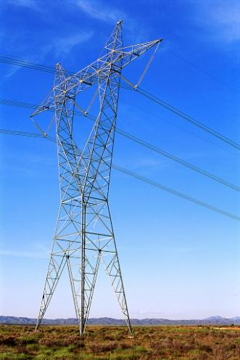
Electrical Circuits
Voltage
  Potential difference
  Volts
Current
  Flow of electrons
  Amps
Resistance
  Conductivity
  Ohms (R)
Power
  Watts
  Volts * Amps
AC versus DC
Unit 1.3 Power Supplies
Slide <number>

Slide 4
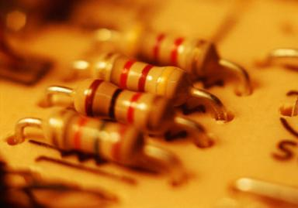
Electrical Components
Conductor
Insulator
Semiconductor
Resistor
Diode
Fuse
Transistor
Capacitor
Unit 1.3 Power Supplies
Slide <number>

Slide 5
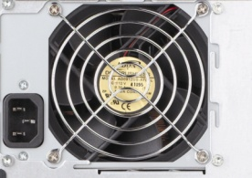
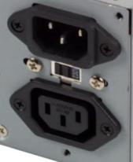
Power Supply Unit (PSU)
AC – DC (3.3V, 5V, 12V) power conversion
Dual voltage (110 vs 240 VAC) options
Maximum power output / wattage / sizing
Form factors
  ATX
  SFX12V (smaller all round)
  TFX12V (long and narrow)
Unit 1.3 Power Supplies
Slide <number>

Slide 6
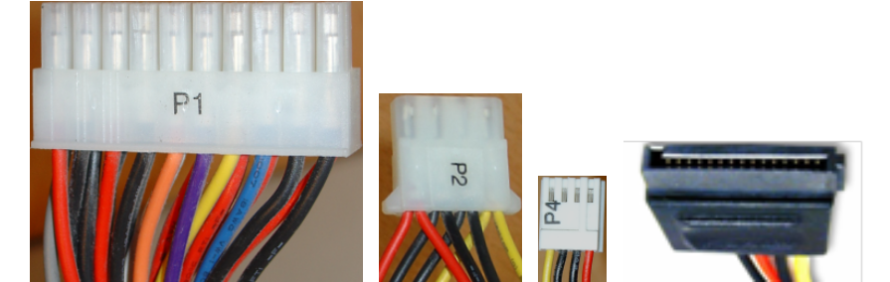
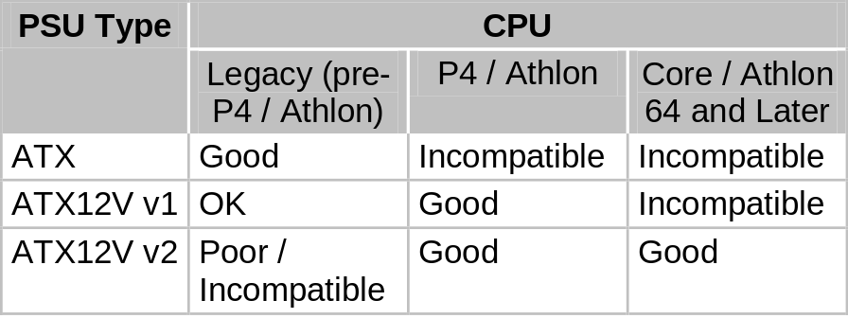
Connector Types and Voltages
ATX
  20-pin P1 (±12V, +5V, and +3.3V)
  4-pin Molex (+12V and +5V)
  4-pin mini-Molex (or Berg)
  6-pin AUX (+5V and +3.3V)
ATX12V v1.x
  4-pin +12V
  SATA (optional)
ATX12V v2.x
  24-pin P1
  SATA (+12V, +5V, and +3.3V )
  6- and 8-pin PCIe (+12V)
EPS12V
  8-pin +12V
Unit 1.3 Power Supplies
Slide <number>

Slide 7
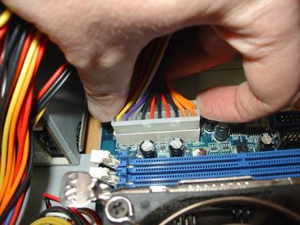
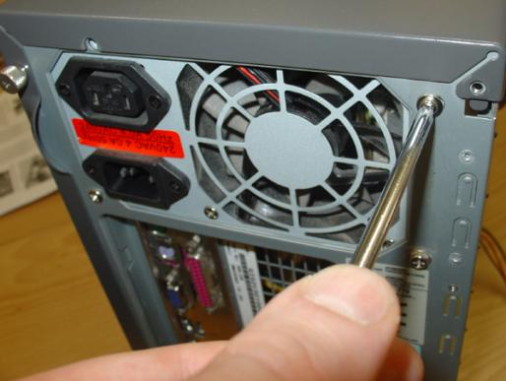
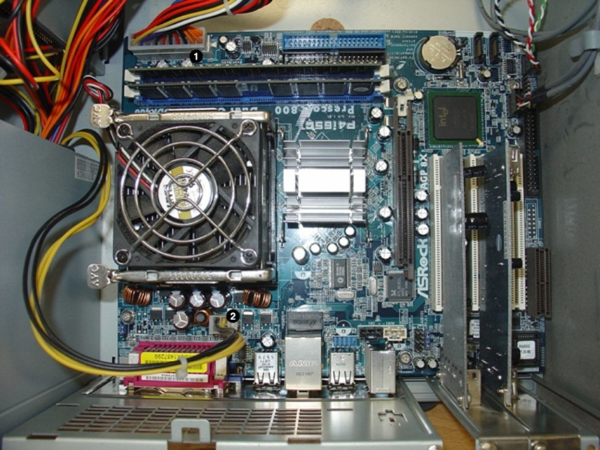
Installing a PSU
Remove connectors
Unscrew from case
Install new PSU – set AC input type if manually switched
Make power and fan connections to motherboard and storage drives
Unit 1.3 Power Supplies
Slide <number>

Slide 8
Identify the parts and connectors of a PC Power Supply Unit (PSU)
Select and install a PSU appropriate to a given PC system
Unit 1.3 Power Supplies
Slide <number>

Slide 9
Lab 2 Identifying PC Components
Unit 1.3 Power Supplies
Slide <number>

